Slide 1

JS

Slide 2
What is JS?
JavaScript is a programming language that allows you to make web pages interactive. Where HTML and CSS are languages that give structure and style to web pages, JavaScript gives web pages interactive elements that engage a user.

Slide 3
Focus points:
Variables
Data Types
Conditionals
Developer Tools
Functions

Slide 4
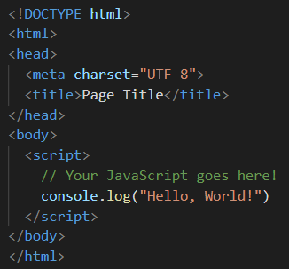
How to run JavaScript code?
All JavaScript we will be writing, in most of this course, will be run via the browser. The simplest way to get started is to simply create an HTML file with the JavaScript code inside of it. Type the basic HTML skeleton into a file on your computer somewhere:
Note: console.log() is the command to print something to the developer console in your browser. You can use this to print the results from any of the following articles and exercises to the console. We encourage you to code along with all of the examples in this and future lessons.

Slide 5
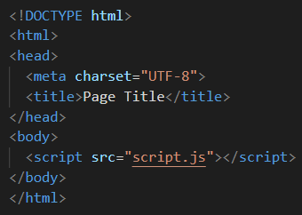
How to run JavaScript code?
Another way to include JavaScript in a web page is through an external script. This is very similar to linking external CSS docs to your website. JavaScript files have the extension .js like .css for stylesheets. External JavaScript files are used for more complex scripts.

Slide 6
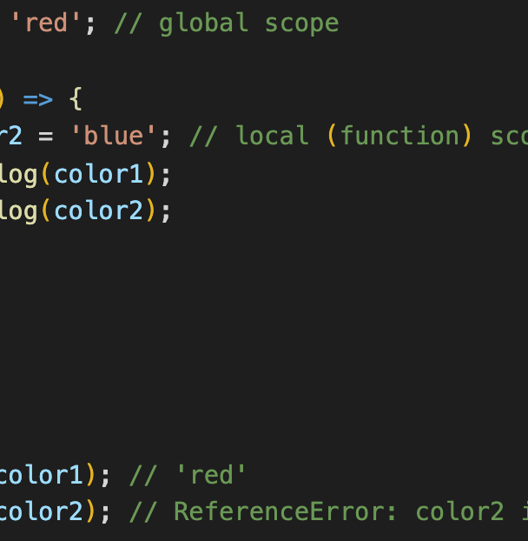
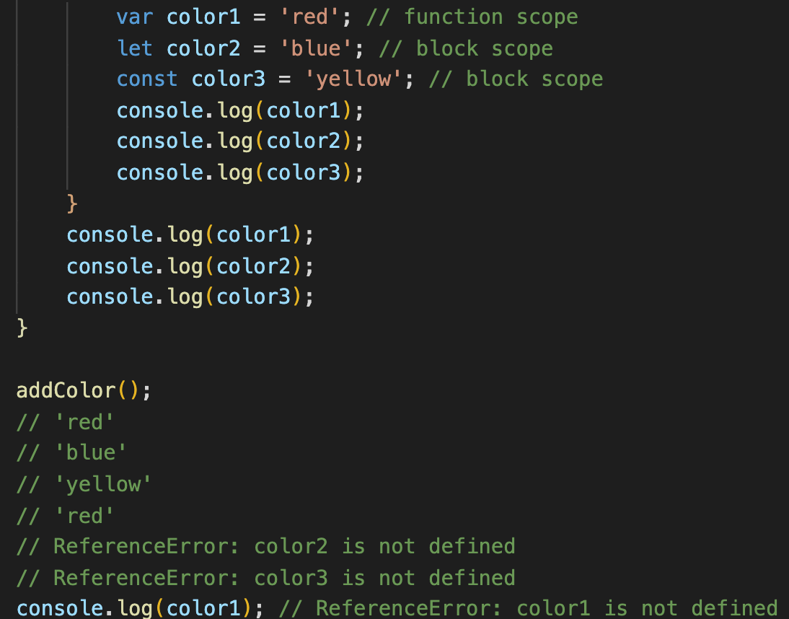
Variables
JAVASCRIPT

Slide 7
Variables
JavaScript variables are containers for storing data values. Here are some of the types we will cover:
Numbers
Strings
Boolean
Null
Undefined
Objects

Slide 8
Variables
You can think of variables as simply “storage containers” for data in your code. Until recently there was only one way to create a variable in JavaScript — the var statement. But in the newest JavaScript versions we have two more ways — let and const.
let and const are both relatively new ways to declare variables in JavaScript. In many tutorials (and code) across the internet you’re likely to encounter var statements. The main difference between let and var is that scope of a variable defined with let is limited to the block in which it is declared while variable declared with var has the global scope. So, we can say that var is rather a keyword which defines a variable globally regardless of block scope.

Slide 9


Variables
The statement below creates (in other words declares) a variable with the name “message”:
Now, we can put some data into it by using the assignment operator =
The string is now saved into the memory area associated with the variable. We can access it using the variable name:
To be concise, we can combine the variable declaration and assignment into a single line:

Slide 10



Variables
We can also declare multiple variables in one line which might seem shorter, but we don’t recommend it. For the sake of better readability, please use a single line per variable:
The multiline variant is a bit longer, but easier to read:
Some people also define multiple variables in these multiline styles:

Slide 11
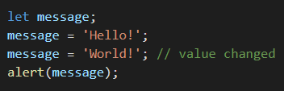
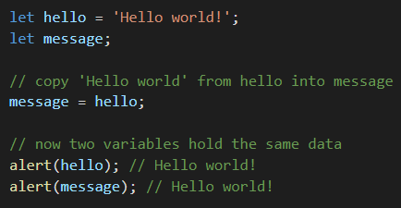
Variables
We can easily grasp the concept of a “variable” if we imagine it as a “box” for data, with a uniquely-named sticker on it. For instance, the variable message can be imagined as a box labeled "message" with the value "Hello!" in it. We can put any value in the box and we can also change it as many times as we want:
When the value is changed, the old data is removed from the variable.
We can also declare two variables and copy data from one into the other.

Slide 12

Variables - naming
There are two limitations on variable names in JavaScript:
The name must contain only letters, digits, or the symbols $ and _
The first character must not be a digit.
Examples of valid names:
When the name contains multiple words, camelCase is commonly used. That is: words go one after another, each word except first starting with a capital letter: myVeryLongName.

Slide 13


Variables - naming
The dollar sign '$' and the underscore '_' can also be used in names. They are regular symbols, just like letters, without any special meaning. So, these names are valid:
Examples of incorrect variable names:
⚠ Important note: Variables are case-sensitive, so variables named chocolate and CHOCOLATE and cHocOlAtE are not the same.

Slide 14

Variables - naming
Non-Latin letters are allowed, but not recommended. It is possible to use any language, including Cyrillic letters or even hieroglyphs, like this:
Technically, there is no error here. Such names are allowed, but there is an international convention to use English in variable names. Even if we’re writing a small script, it may have a long life ahead. People from other countries may need to read it some time.

Slide 15

Variables - naming
There is a list of reserved words, which cannot be used as variable names because they are used by the language itself. For example: var, let, class, return, and function are reserved. The code below gives a syntax error:

Slide 16

Variables - constants
To declare a constant (unchanging) variable, use const instead of let:
Variables declared using const are called “constants”. They cannot be reassigned. An attempt to do so would cause an error:
When a programmer is sure that a variable will never change, they can declare it with const to guarantee and clearly communicate that fact to everyone.

Slide 17
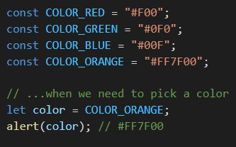
Variables – uppercase constants
There is a widespread practice to use constants as aliases for difficult-to-remember values that are known prior to execution. Such constants are named using capital letters and underscores. For instance, let’s make constants for colors in so-called “web” (hexadecimal) format:
Benefits:
COLOR_ORANGE is much easier to remember than "#FF7F00".
It is much easier to mistype "#FF7F00" than COLOR_ORANGE.
When reading the code, COLOR_ORANGE is much more meaningful than #FF7F00.

Slide 18
Variables – naming conventions
A variable name should have a clean, obvious meaning, describing the data that it stores. Variable naming is one of the most important and complex skills in programming. A quick glance at variable names can reveal which code was written by a beginner versus an experienced developer.
In a real project, most of the time is spent modifying and extending an existing code base rather than writing something completely separate from scratch. When we return to some code after doing something else for a while, it’s much easier to find information that is well-labeled. Or, in other words, when the variables have good names.

Slide 19
Variables – naming conventions
Some good-to-follow rules are:
Use human-readable names like userName or shoppingCart.
Stay away from abbreviations or short names like a, b, c, unless you really know what you’re doing.
Make names maximally descriptive and concise. Examples of bad names are data and value. Such names say nothing. It’s only okay to use them if the context of the code makes it exceptionally obvious which data or value the variable is referencing.
Agree on terms within your team and in your own mind. If a site visitor is called a “user” then we should name related variables currentUser or newUser instead of currentVisitor or newManInTown.

Slide 20
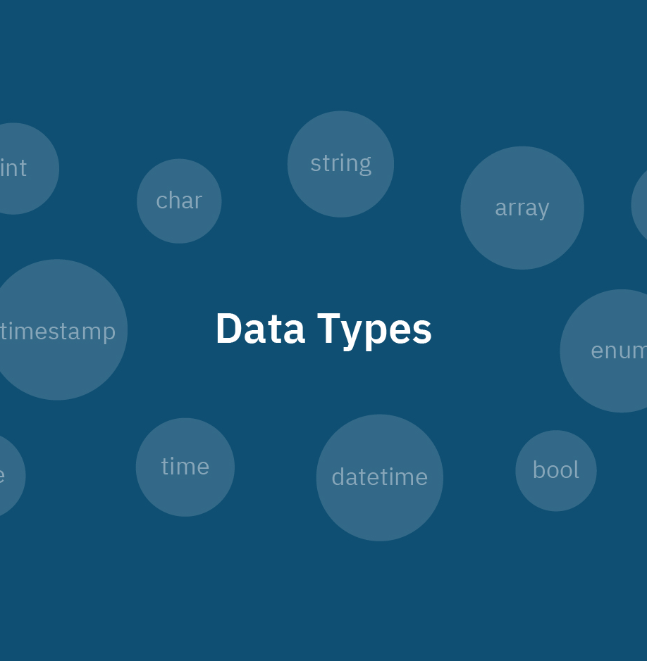
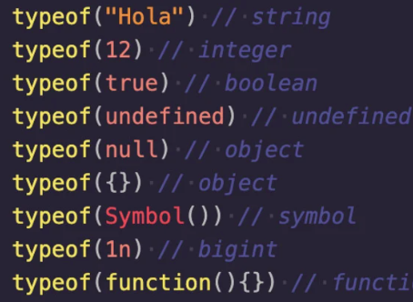
Data Types
JAVASCRIPT

Slide 21

Data Types
A value in JavaScript is always of a certain type. For example, a string or a number.
There are eight basic data types in JavaScript.
We can put any type in a variable. For example, a variable can at one moment be a string and then store a number:
Programming languages that allow such things, such as JavaScript, are called “dynamically typed”, meaning that there exist data types, but variables are not bound to any of them.

Slide 22
Numbers
Numbers are the building blocks of programming logic! In fact, it’s hard to think of any useful programming task that doesn’t involve at least a little basic math. So, knowing how numbers work is obviously quite important. Luckily, it’s also fairly straightforward.
This W3Schools lesson followed by this one, are good introductions to what you can accomplish with numbers in JavaScript.
This MDN article covers the same info from a slightly different point of view, while also teaching you how to apply some basic math in JavaScript. There’s much more that you can do with numbers, but this is all you need at the moment.
Read through (and code along with!) this article about operators in JavaScript. It will give you a pretty good idea of what you can accomplish with numbers in JavaScript.

Slide 23

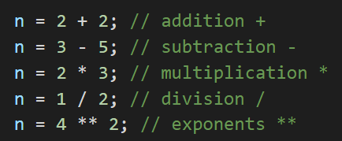
Numbers
The number type represents both integer and floating point numbers.
There are many operations for numbers such as:

Slide 24
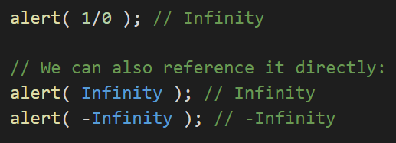
Numbers
Besides regular numbers, there are so-called “special numeric values” which also belong to this data type: Infinity, -Infinity and NaN. Infinity represents the mathematical infinity. It is a special value that is bigger than any other number. We can get it as a result of division by zero:

Slide 25
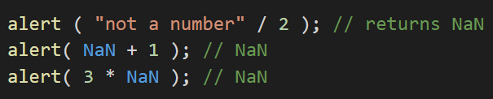
Numbers
NaN represents a computational error. It is a result of an incorrect or an undefined mathematical operation, for instance:

Slide 26
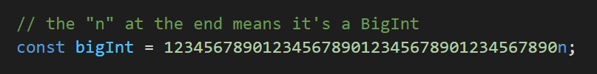
Numbers - BigInt
In JavaScript, the “number” type cannot represent integer values larger than (2^53-1) (that’s 9007199254740991), or less than -(2^53-1) for negatives. It’s a technical limitation caused by their internal representation.
For most purposes that’s quite enough, but sometimes we need really big numbers, e.g. for cryptography.
BigInt type was recently added to the language to represent integers of arbitrary length.
A BigInt value is created by appending n to the end of an integer:

Slide 27
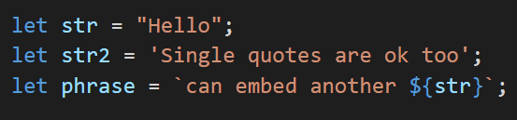
Strings
A string is a sequence of one or more characters that may consist of letters, numbers, or symbols. A string in JavaScript must be surrounded by quotes.
In JavaScript, there are 3 types of quotes:
Double quotes: "Hello".
Single quotes: 'Hello’.
Backticks: `Hello`.
Double and single quotes are “simple” quotes. There’s practically no difference between them in JavaScript.

Slide 28
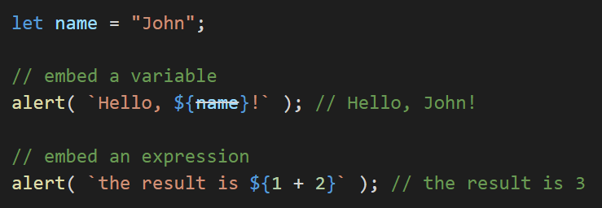
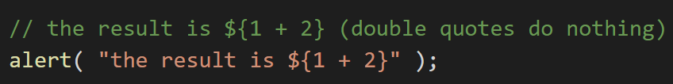
Strings
Backticks are “extended functionality” quotes. They allow us to embed variables and expressions into a string by wrapping them in ${…}, for example:
The expression inside ${…} is evaluated and the result becomes a part of the string. We can put anything in there: a variable like name or an arithmetical expression like 1 + 2 or something more complex.
⚠ Important note: This can only be done in backticks. Other quotes don’t have this embedding functionality!

Slide 29

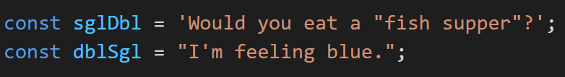
Strings
There is very little difference between the single and double quotes, and which you use is down to personal preference. You should choose one and stick to it, however; differently quoted code can be confusing, especially if you use two different quotes on the same string! The following will return an error:
The browser will think the string has not been closed because the other type of quote you are not using to contain your strings can appear in the string. For example, both of these are okay:

Slide 30

Strings
However, you can't include the same quote mark inside the string if it's being used to contain them. The following will error, as it confuses the browser as to where the string ends:
To fix our previous problem code line, we need to escape the problem quote mark. Escaping characters means that we do something to them to make sure they are recognized as text, not part of the code. In JavaScript, we do this by putting a backslash just before the character:
See escape sequences for more details.

Slide 31

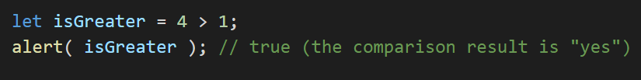
Booleans
The boolean type has only two values: true and false. This type is commonly used to store yes/no values: true means “yes, correct”, and false means “no, incorrect”. For instance:
Boolean values also come as a result of comparisons:

Slide 32

Null
The special null value does not belong to any of the types described above. It forms a separate type of its own which contains only the null value:
In JavaScript, null is not a “reference to a non-existing object” or a “null pointer” like in some other languages. It’s just a special value which represents “nothing”, “empty” or “value unknown”. So the code above states that age is unknown.

Slide 33

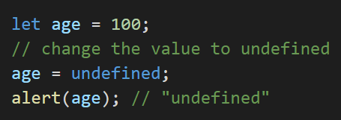
Undefined
The special value undefined also stands apart. It makes a type of its own, just like null. The meaning of undefined is “value is not assigned”. If a variable is declared, but not assigned, then its value is undefined:
Technically, it is possible to explicitly assign undefined to a variable:
Note: We don’t recommend doing that. Normally, one uses null to assign an “empty” or “unknown” value to a variable, while undefined is reserved as a default initial value for unassigned things.

Slide 34
Objects
The object type is special. All other types are called “primitive” because their values can contain only a single thing (be it a string or a number or whatever). In contrast, objects are used to store collections of data and more complex entities.
In JavaScript, objects penetrate almost every aspect of the language. So we must understand them first before going in-depth anywhere else. An object can be created with figure brackets {…} with an optional list of properties. A property is a “key: value” pair, where key is a string (also called a “property name”), and value can be anything.
An empty object can be created using one of two syntaxes:
Usually, the figure brackets {...} are used. That declaration is called an object literal. Here’s the difference between the two.

Slide 35
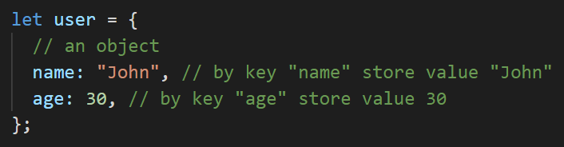
Objects
We can immediately put some properties into {...} as “key: value” pairs:
A property has a key (also known as “name” or “identifier”) before the colon ":" and a value to the right of it. In the user object, there are two properties:
The first property has the name "name" and the value "John".
The second one has the name "age" and the value 30.

Slide 36
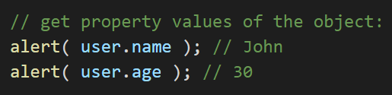


Objects
We can add, remove and read files from it at any time. Property values are accessible using the dot notation:
The value can be of any type. Let’s add a boolean one:
To remove a property, we can use the delete operator:

Slide 37
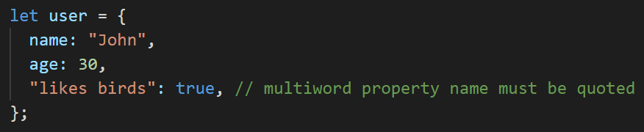
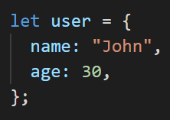
Objects
We can also use multiword property names, but then they must be quoted:
The last property in the list may end with a comma:
That is called a “trailing” or “hanging” comma. Makes it easier to add/remove/move around properties, because all lines become alike.

Slide 38

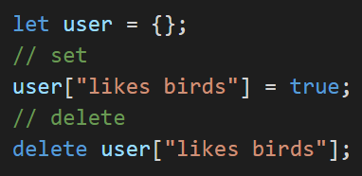
Objects
For multiword properties, the dot access doesn’t work:
JavaScript doesn’t understand that. It thinks that we address user.likes, and then gives a syntax error when it comes across unexpected birds. The dot requires the key to be a valid variable identifier. That implies: contains no spaces, doesn’t start with a digit and doesn’t include special characters ($ and _ are allowed).
There’s an alternative “square bracket notation” that works with any string:
Note: Any type of quotes will work.

Slide 39
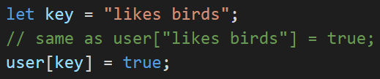
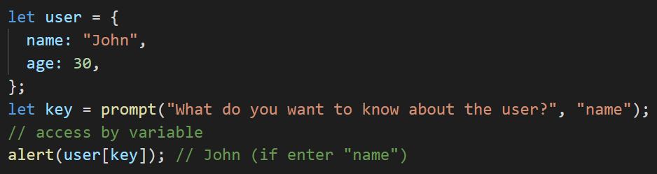
Objects
Square brackets also provide a way to obtain the property name as the result of any expression – as opposed to a literal string – like from a variable as follows:
Here, the variable key may be calculated at run-time or depend on the user input. And then we use it to access the property. That gives us a great deal of flexibility. For instance:

Slide 40
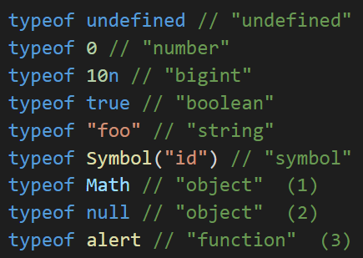
Typeof operator
The typeof operator returns the type of the argument. It’s useful when we want to process values of different types differently or just want to do a quick check. A call to typeof x returns a string with the type name:
(1) Math is a built-in object that provides mathematical operations. We will learn it in the chapter Numbers. Here, it serves just as an example of an object.
(2) The result of typeof null is "object". That’s an officially recognized error in typeof, coming from very early days of JavaScript and kept for compatibility. Definitely, null is not an object. It is a special value with a separate type of its own. The behavior of typeof is wrong here.
(3) The result of typeof alert is "function", because alert is a function. We’ll study functions in the next chapters where we’ll also see that there’s no special “function” type in JavaScript. Functions belong to the object type. But typeof treats them differently, returning "function". That also comes from the early days of JavaScript.

Slide 41
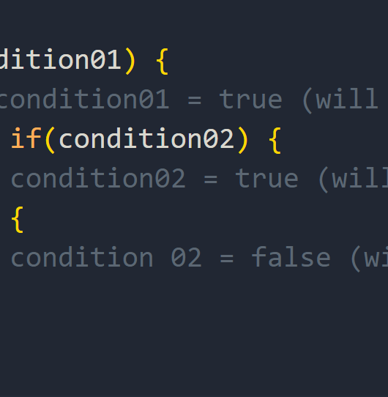
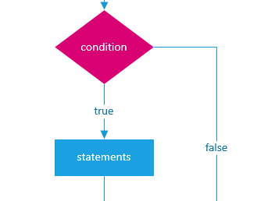
Conditionals
JAVASCRIPT

Slide 42
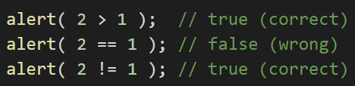
Conditionals
We know many comparison operators from math. In JavaScript they are written like this:
Greater/less than: a > b, a < b.
Greater/less than or equals: a >= b, a <= b.
Equals: a == b, please note the double equality sign == means the equality test, while a single one a = b means an assignment.
Not equals: In math the notation is ≠, but in JavaScript it’s written as a != b.
All comparison operators return a boolean value:
true – means “yes”, “correct” or “the truth”.
false – means “no”, “wrong” or “not the truth”.

Slide 43
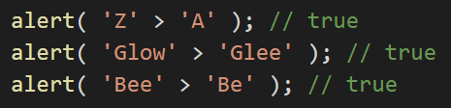
Conditionals – string comparison
To see whether a string is greater than another, JavaScript uses the so-called “dictionary” or “lexicographical” order. In other words, strings are compared letter-by-letter. For example:
The algorithm to compare two strings is simple:
Compare the first character of both strings.
If the first character from the first string is greater (or less) than the other string’s, then the first string is greater (or less) than the second. We’re done.
Otherwise, if both strings’ first characters are the same, compare the second characters the same way.
Repeat until the end of either string.
If both strings end at the same length, then they are equal. Otherwise, the longer string is greater.

Slide 44


Conditionals – different type comparison
A regular equality check == has a problem. It cannot differentiate 0 from false:
The same thing happens with an empty string:
This happens because operands of different types are converted to numbers by the equality operator ==

Slide 45
Conditionals – different type comparison
An empty string, just like false, becomes a zero. What to do if we’d like to differentiate 0 from false? A strict equality operator === checks the equality without type conversion. In other words, if a and b are of different types, then a === b immediately returns false without an attempt to convert them. Let’s try it:
There is also a “strict non-equality” operator !== analogous to !=. The strict equality operator is a bit longer to write, but makes it obvious what’s going on and leaves less room for errors.

Slide 46
Conditionals – null and undefined
There’s a non-intuitive behavior when null or undefined are compared to other values.
For a strict equality check ===
These values are different, because each of them is a different type.
For a non-strict check ==
There’s a special rule. These two are a “sweet couple”: they equal each other (in the sense of ==), but not any other value.
For maths and other comparisons < > <= >=
null/undefined are converted to numbers: null becomes 0, while undefined becomes NaN.

Slide 47
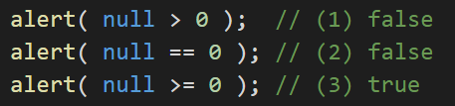
Conditionals – null and undefined
Let’s compare null with a zero:
Mathematically, that’s strange. The last result states that "null is greater than or equal to zero", so in one of the comparisons above it must be true, but they are both false.
The reason is that an equality check == and comparisons > < >= <= work differently. Comparisons convert null to a number, treating it as 0. That’s why (3) null >= 0 is true and (1) null > 0 is false.
On the other hand, the equality check == for undefined and null is defined such that, without any conversions, they equal each other and don’t equal anything else. That’s why (2) null == 0 is false.

Slide 48
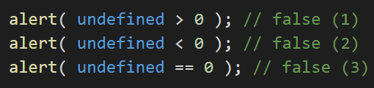
Conditionals – null and undefined
The value undefined shouldn’t be compared to other values:
Why is it always false? We get these results because:
Comparisons (1) and (2) return false because undefined gets converted to NaN and NaN is a special numeric value which returns false for all comparisons.
The equality check (3) returns false because undefined only equals null, undefined, and no other value.
Treat any comparison with undefined/null except the strict equality === with exceptional care.
Don’t use comparisons >= > < <= with a variable which may be null/undefined, unless you’re really sure of what you’re doing. If a variable can have these values, check for them separately.

Slide 49
Conditional statements
Very often when you write code, you want to perform different actions for different decisions. You can use conditional statements in your code to do this. In JavaScript we have the following conditional statements:
Use if to specify a block of code to be executed, if a specified condition is true
Use else to specify a block of code to be executed, if the same condition is false
Use else if to specify a new condition to test, if the first condition is false
Use switch to specify many alternative blocks of code to be executed

Slide 50
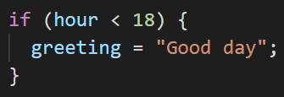
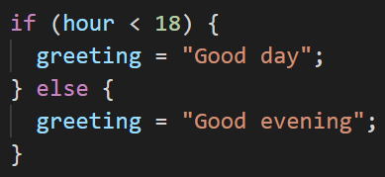
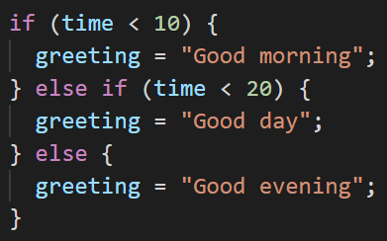
Conditional statements - examples
Make a "Good day" greeting if the hour is less than 18:00:
If the hour is less than 18, create a "Good day" greeting, otherwise "Good evening":
If time is less than 10:00, create a "Good morning" greeting, if not, but time is less than 20:00, create a "Good day" greeting, otherwise a "Good evening":

Slide 51
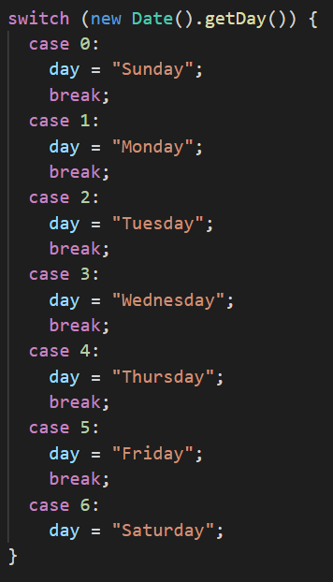
Conditional statements – switch statement
How switch statements work:
The switch expression is evaluated once.
The value of the expression is compared with the values of each case.
If there is a match, the associated block of code is executed.
If there is no match, the default code block is executed
The getDay() method returns the weekday as a number between 0 and 6. (Sunday=0, Monday=1, Tuesday=2 ..)
This example on the right uses the weekday number to calculate the weekday name.

Slide 52
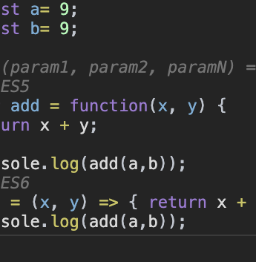
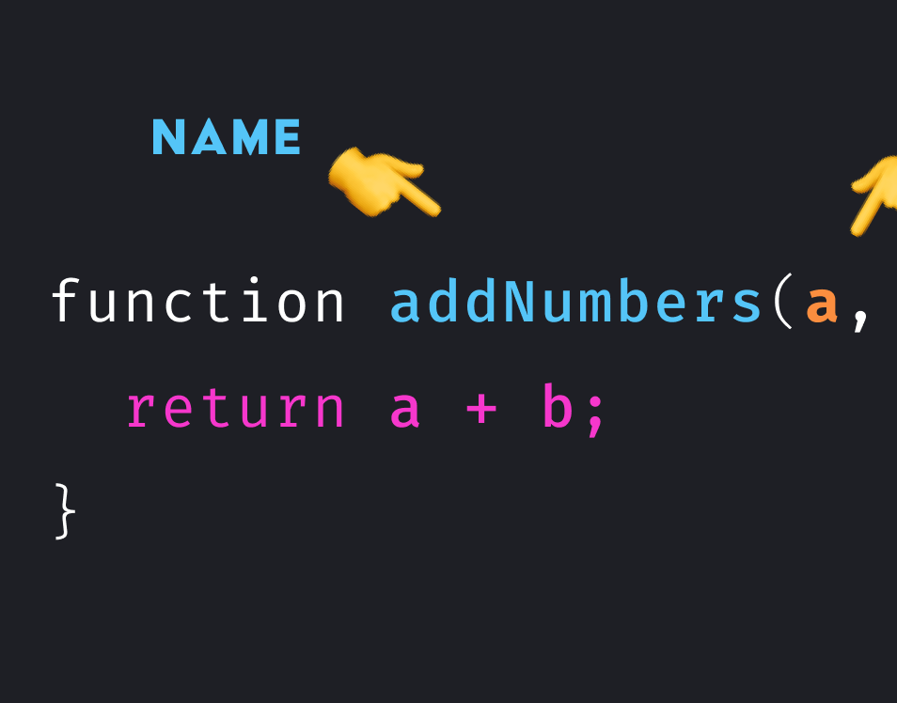
Functions
JAVASCRIPT

Slide 53
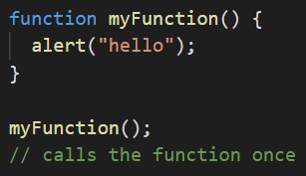
Functions
Functions allow you to store a piece of code that does a single task inside a defined block, and then call that code whenever you need it using a single short command — rather than having to type out the same code multiple times. In this article we'll explore fundamental concepts behind functions such as basic syntax, how to invoke and define them, scope, and parameters.
The built-in code we've made use of so far comes in both forms: functions and methods. You can check the full list of the built-in functions, as well as the built-in objects and their corresponding methods here.
To actually use a function after it has been defined, you've got to run — or invoke — it. This is done by including the name of the function in the code somewhere, followed by parentheses:

Slide 54

Function parameters
Some functions require parameters to be specified when you are invoking them — these are values that need to be included inside the function parentheses, which it needs to do its job properly. As an example, the browser's built-in Math.random() function doesn't require any parameters. When called, it always returns a random number between 0 and 1:
The browser's built-in string replace() function however needs two parameters — the substring to find in the main string, and the substring to replace that string with:

Slide 55
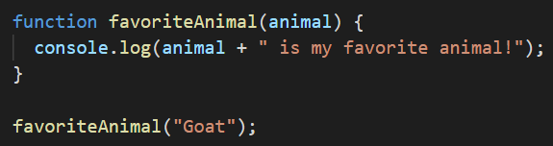
Function parameters
In JavaScript, parameters are the items listed between the parentheses in the function declaration. Function arguments are the actual values we decide to pass to the function. In the example below, the function definition is written on the first line: function favoriteAnimal(animal). The parameter, animal, is found inside the parentheses. We could just as easily replace animal with pet, x, or blah. But in this case, naming the parameter animal gives someone reading our code a bit of context so that they don’t have to guess what animal may eventually contain. By putting animal inside the parentheses of the favoriteAnimal() function, we are telling JavaScript that we will send some value to our favoriteAnimal function. This means that animal is just a placeholder for some future value.
The last line, favoriteAnimal('Goat'), is where we are calling our favoriteAnimal function and passing the value Goat inside that function.

Slide 56
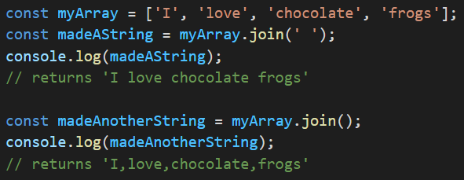
Function parameters
Sometimes parameters are optional — you don't have to specify them. If you don't, the function will generally adopt some kind of default behavior. As an example, the array join() function's parameter is optional:
If no parameter is included to specify a joining/delimiting character, a comma is used by default.

Slide 57
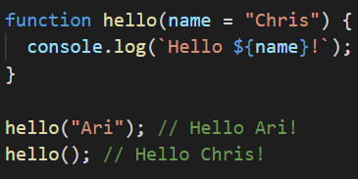
Function parameters
If you're writing a function and want to support optional parameters, you can specify default values by adding = after the name of the parameter, followed by the default value:

Slide 58


Anonymous functions and arrow functions
So far we have just created a function like so:
But you can also create a function that doesn't have a name:
This is called an anonymous function, because it has no name. You'll often see anonymous functions when a function expects to receive another function as a parameter. In this case the function parameter is often passed as an anonymous function. An anonymous function is not accessible after its initial creation, it can only be accessed by a variable it is stored in as a function as a value. An anonymous function can also have multiple arguments, but only one expression.

Slide 59
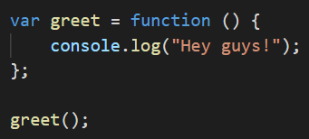
Anonymous functions and arrow functions
In this example, we define an anonymous function that prints a message to the console. The function is then stored in the greet variable. We can call the function by invoking greet().

Slide 60

Anonymous functions and arrow functions
There’s another very simple and concise syntax for creating functions, that’s often better than Function Expressions. It’s called “arrow functions”, because it looks like this:
This creates a function func that accepts arguments arg1..argN, then evaluates the expression on the right side with their use and returns its result. In other words, it’s the shorter version of:

Slide 61
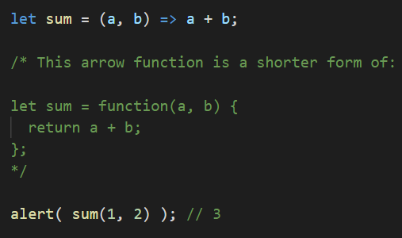
Anonymous functions and arrow functions
Let’s see a concrete example:
As you can see, (a, b) => a + b means a function that accepts two arguments named a and b. Upon the execution, it evaluates the expression a + b and returns the result.

Slide 62
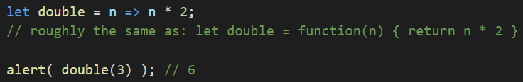

Anonymous functions and arrow functions
If we have only one argument, then parentheses around parameters can be omitted, making that even shorter.
If there are no arguments, parentheses are empty, but they must be present:
Arrow functions may appear unfamiliar and not very readable at first, but that quickly changes as the eyes get used to the structure. They are very convenient for simple one-line actions, when we’re just too lazy to write many words.

Slide 63
Function scopes
Let's talk a bit about scope — a very important concept when dealing with functions. When you create a function, the variables and other things defined inside the function are inside their own separate scope, meaning that they are locked away in their own separate compartments, unreachable from code outside the functions.
The top level outside all your functions is called the global scope. Values defined in the global scope are accessible from everywhere in the code.
JavaScript is set up like this for various reasons — but mainly because of security and organization. Sometimes you don't want variables to be accessible from everywhere in the code — external scripts that you call in from elsewhere could start to mess with your code and cause problems because they happen to be using the same variable names as other parts of the code, causing conflicts. This might be done maliciously, or just by accident.

Slide 64
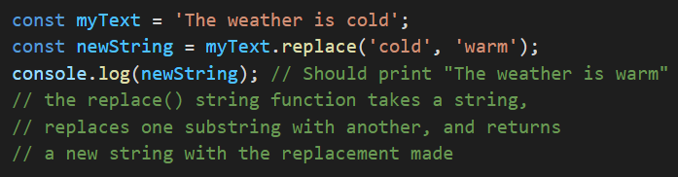
Return values
Return values are just what they sound like — the values that a function returns when it has completed. You've already met return values a number of times, although you may not have thought about them explicitly.
The replace() function is invoked on the myText string, and is passed two parameters:
the substring to find ('cold').
the string to replace it with ('warm').
When the function completes (finishes running), it returns a value, which is a new string with the replacement made. In the code above, the result of this return value is saved in the variable newString.

Slide 65

Assignment
aleksa.fd.tutor@gmail.com

Slide 66
Thank you for your attention!

